Slide 1
PROJECT START BUILDING THE DISASTER RECOVERY PLAN USING IBM VIRTUAL COULD SERVER

Slide 2
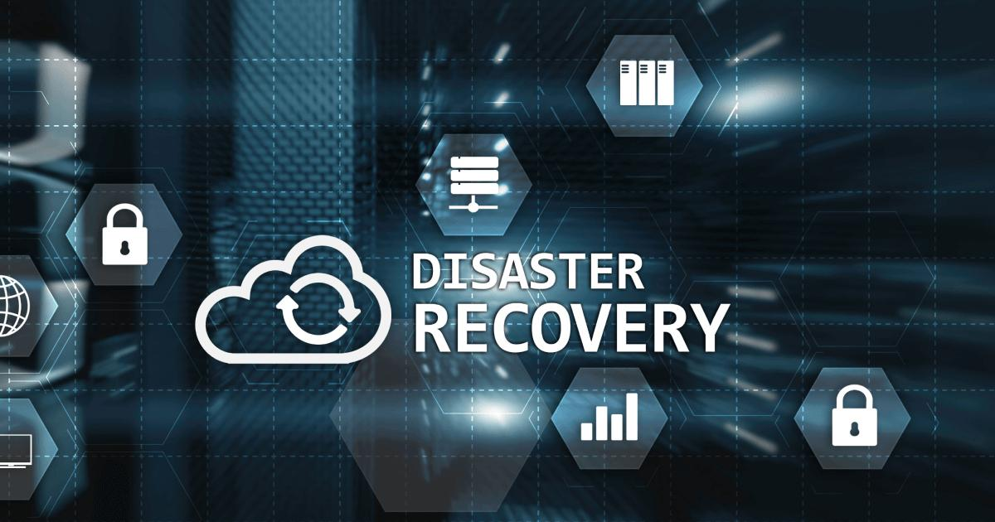
TOPIC

Slide 3
DISASTER RECOVERY
Disaster recovery is a crucial part of ensuring the continuity of your IT infrastructure in the event of unexpected disasters. It involves planning and implementing strategies to recover systems and data efficiently. Here’s an overview of key disaster recovery concepts, including RTO (Recovery Time Objective), RPO (Recovery Point Objective), and prioritization of virtual machines:

Slide 4
Step 1: Define Objectives and Scope
Clearly define the objectives of your disaster recovery plan, including minimizing downtime and data loss. Identify the scope of your disaster recovery plan, specifying which workloads and data will be covered.

Slide 5
Step 2: Identify Critical Workloads and Data
Identify the critical workloads and data that need protection. Prioritize these workloads based on their criticality to your business operations.

Slide 6
Step 3: Assess Risks and Vulnerabilities Conduct a risk assessment to identify potential disaster scenarios, such as hardware failure, data corruption, natural disasters, or cyberattacks. Assess the impact and likelihood of each scenario on your business.

Slide 7
Step 4: Set RTO and RPO Targets
Define your Recovery Time Objectives (RTO) and Recovery Point Objectives (RPO) for each workload and data set.
RTO: The maximum allowable downtime.
RPO: The maximum allowable data loss.

Slide 8
Step 5: Choose IBM Virtual Cloud Servers If not already using IBM Virtual Cloud Servers, provision the necessary resources in the IBM Cloud, including the selection of geographic regions for redundancy.

Slide 9
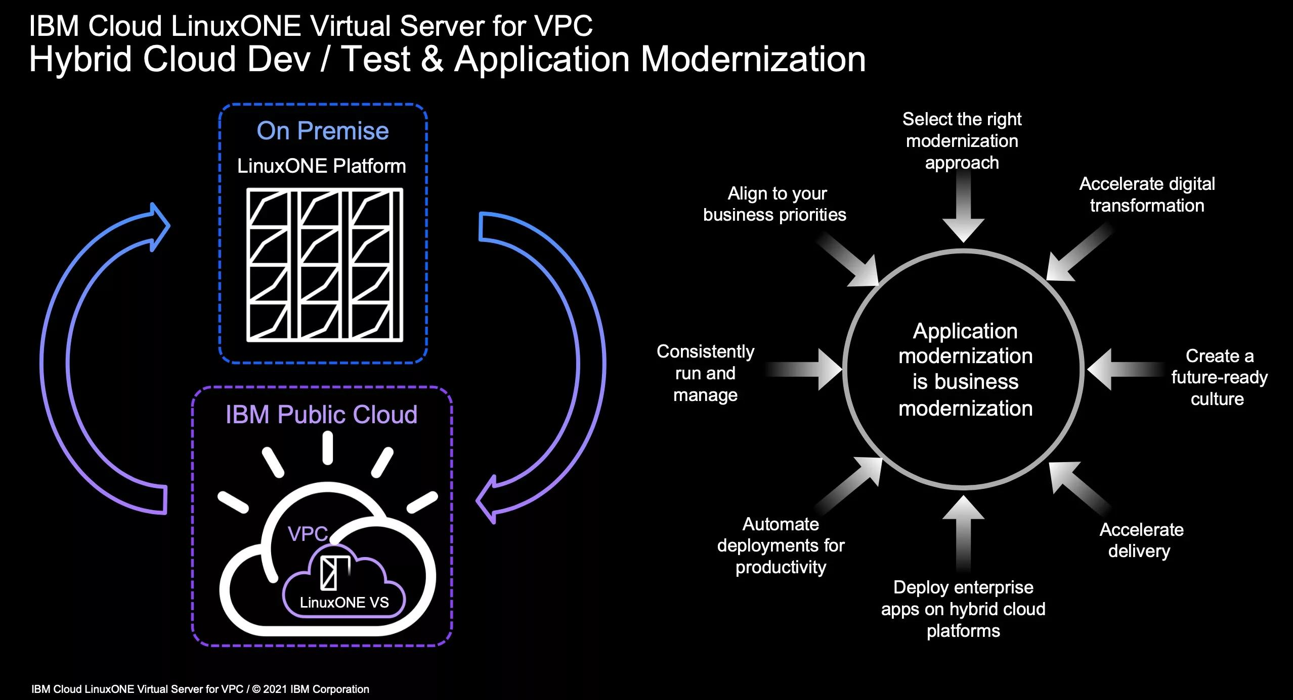
Cloud servers

Slide 10
Step 6: Select a Disaster Recovery Strategy
Based on your risk assessment and RTO/RPO values, choose a disaster recovery strategy. Common strategies include:
Continuous Replication (Hot Standby): This strategy involves continuous data replication to minimize RTO and RPO.
Scheduled Replication (Warm Standby): Scheduled backups or snapshots help achieve RTO and RPO goals.
Periodic Backups (Cold Standby): Regular backups are taken to meet RPO objectives, and restoration occurs in the event of a disaster.

Slide 11
Step 7: Implement Data Backup and Replication Implement data backup and replication solutions to meet your RTO and RPO objectives. Use IBM Cloud services such as IBM Cloud Object Storage for backups and IBM Cloud Virtual Servers for replication.

Slide 12

IMAGE

Slide 13
Step 8: Configure Failover and Recovery Processes Implement automated failover processes that can quickly redirect traffic to the standby environment. Ensure that your failover process aligns with your RTO objectives.

Slide 14
Step 9: Test and Validate Your Plan
Regularly test your disaster recovery procedures to ensure they work as expected.
Perform tests of various scenarios, from data corruption to full site failover.
Adjust your plan based on the results of these tests.

Slide 15
Step 10: Monitor and Maintain Continuously monitor your production and standby environments. Keep your disaster recovery plan up to date to reflect changes in your infrastructure or RTO/RPO requirements.

Slide 16
Step 13: Continuous Improvement Periodically review your plan and make adjustments based on lessons learned from testing and real-world events. Adapt to changes in technology and your business needs, ensuring your RTO and RPO goals are still appropriate.

Slide 17

IMPROVEMENT

Slide 18
CONCLUSION
A well-designed and tested disaster recovery plan that includes RTO and RPO considerations will help ensure the resilience and availability of your critical workloads and data in the face of unexpected disasters.
Remember that building a robust disaster recovery plan is an ongoing process. It requires careful planning, regular testing, and adjustments to ensure that your critical workloads and data remain secure and accessible, even in the face of unforeseen disasters.

Slide 19
THANKING YOU

Slide 20
Submitted by:
Name: S.Thiyagu
DEP:CSE
COLLEGE: UCE -TKY

